Slide 1
UNLOCKING CIRCULAR ECONOMY: AN ADAPTIVE UPSCALING APPROACH FOR ASSESSING MATERIAL’S CIRCULAR POTENTIAL WITH NON-DESTRUCTIVE TESTING (NDT)
Ghezal Ahmad Jan Zia¹, Christoph Völker¹, Benjamí Moreno Torres², and Sabine Kruschwitz^{1,2}
¹ Bundesanstalt für Materialforschung und -prüfung, Unter den Eichen 87, Berlin, Germany
² Technische Universität Berlin, Gustav-Meyer-Allee 25, Berlin, Germany

Slide 2
Introduction
Circular Economy: A sustainable approach emphasizing resource reuse and optimization to extend the lifespan of materials and structures.
Non-Destructive Testing (NDT): Essential for assessing material integrity in situ without causing damage, crucial for sustainable construction and maintenance.

Slide 3
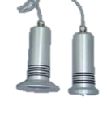
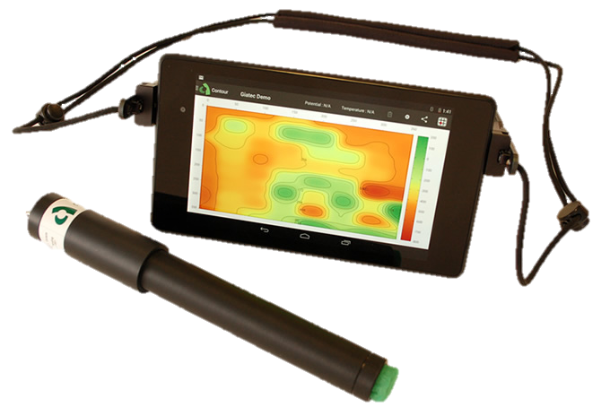

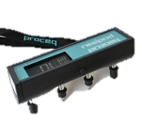
Challenges in Traditional NDT Methods
Challenge:
- Large surfaces vs. localized damage
- Manual effort of hand-held data collection
AI-Assistant: - Navigate directly to areas of interest
- Benchmarked on real-world NDT data:
Reliable and 5 x faster!
Concrete
Innovation
Notes:
Using data from previous nondestructive tests and integrating them with advanced data-driven methods, we have developed an adaptive sampling algorithm that significantly enhances resource efficiency in this activity.
This algorithm leverages NDT data from three distinct tests, like electrical resistivity or electrical potential, each capable of predicting corrosion in the reinforcement bars of a reinforced concrete element.
By applying Sequential Learning techniques, we have formulated an Advanced Adaptive Sampling Algorithm.
This algorithm has demonstrated up to five times greater time efficiency in detecting areas of corrosion

Slide 4
Dataset
Derived from a controlled experiment simulating various corrosion stages in concrete, featuring sensor-based measurements and binary corrosion indicators.
Number of Samples | 50,038
Number of Features | 4
Features | Feature 1: Half-cell potential - rebar potential Feature 2: Half-cell potential - change of rebar potential Feature 3: Wenner-resistivity - electrical resistivity Feature 4: Microwave-moisture - relative moisture of concrete
Label | Binary (0 for No Corrosion), 1,954 (Corrosion)

Slide 5
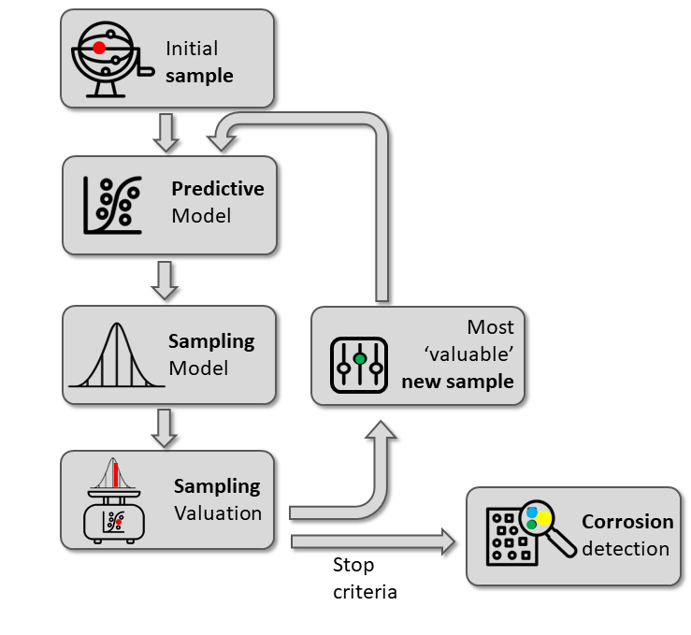
Methodology: AI-driven Adaptive Sampling
RF & LR
GPR
Notes:
Adaptive sampling is a strategy used in various fields, including statistics, machine learning, and environmental science, to efficiently allocate sampling resources. In traditional sampling methods, samples are often collected uniformly across a study area or parameter space. However, in many cases, the points of interest are not uniformly distributed. Adaptive sampling addresses this by adjusting the sampling strategy based on the information gained from initial samples.
The key idea behind adaptive sampling is to 'learn' from the data as it is collected. After initial samples are analyzed, regions or parameters of higher interest, variability, or uncertainty are identified. Subsequent sampling efforts are then concentrated more heavily in these areas. This approach can significantly improve the efficiency and effectiveness of data collection, allowing researchers or algorithms to focus their efforts on the most informative parts of the space.
In practical terms, adaptive sampling might involve initially surveying a broad area to identify regions of interest and then intensifying the sampling effort in those regions to gain more detailed insights. This method is particularly useful in environments where the phenomena of interest are sparsely distributed or when dealing with high-dimensional data spaces in machine learning, where it's crucial to explore the most relevant features more thoroughly

Slide 6
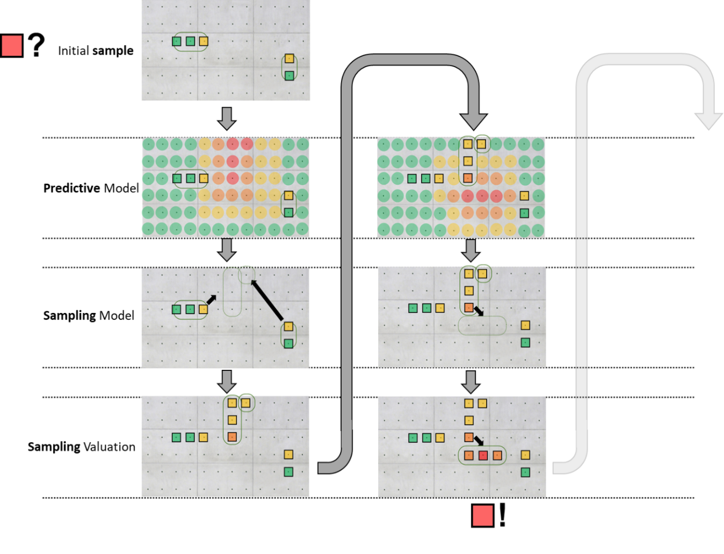
Benchmarking
Notes:
Prediction Likelihood: This parameter assesses the probability or likelihood that a given sample or data point belongs to a particular category or exhibits a specific characteristic of interest. In adaptive sampling, this measure helps prioritize areas or instances that are most likely to yield valuable information according to the model's current understanding.
Diversity Score: The diversity score evaluates how different or unique a sample is compared to already collected samples. By prioritizing high diversity scores, adaptive sampling ensures a broad and varied dataset. This diversity is crucial for avoiding over-sampling of similar instances, which can lead to biased models and overlooked areas in the parameter space.
Uncertainty: This parameter measures the model's confidence in its predictions for a given sample. Samples with high uncertainty are those where the model is least sure of its prediction. By focusing on these uncertain areas, adaptive sampling aims to collect more information where it is needed most, thereby improving the model's performance and confidence over time.
In essence, adaptive sampling uses these parameters to dynamically adjust where it collects data. By considering prediction likelihood, it focuses on probable points of interest; through diversity scoring, it ensures a wide-ranging and representative dataset; and by prioritizing uncertainty, it addresses gaps in the model's knowledge, leading to a more robust and accurate understanding of the studied phenomenon.

Slide 7
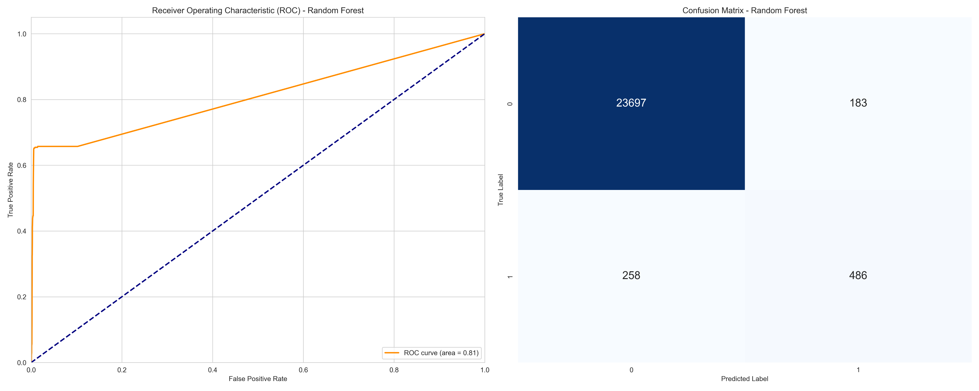
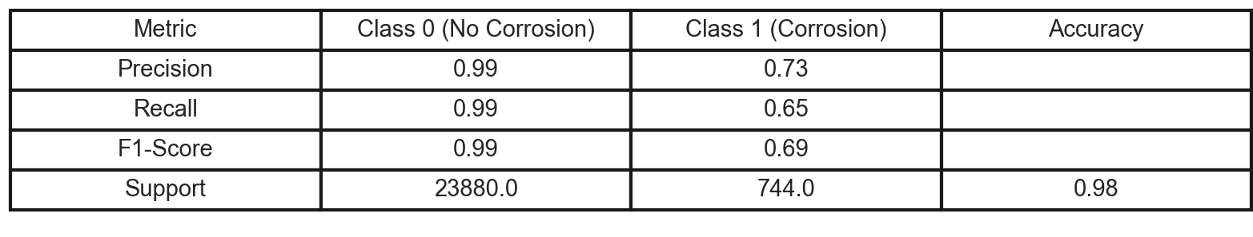
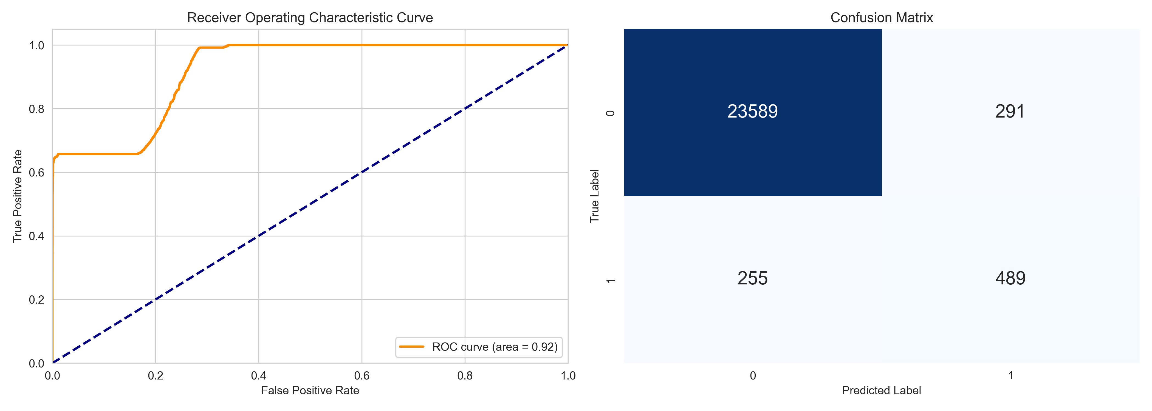

Results
RF
LR
Notes:
True Negatives (TN): 23697 - The number of correctly predicted negative (No Corrosion) instances.
False Positives (FP): 183 - The number of negative instances incorrectly classified as positive (Corrosion).
False Negatives (FN): 258 - The number of positive instances incorrectly classified as negative.
True Positives (TP): 486 - The number of correctly predicted positive (Corrosion) instances.
Precision (Class 0: 0.99, Class 1: 0.73): Precision is the ratio of correctly predicted positive observations to the total predicted positives. High precision for Class 0 indicates that the model is very reliable when it predicts a case as No Corrosion. The precision for Class 1 is lower, suggesting more false positives in the Corrosion predictions.
Recall (Class 0: 0.99, Class 1: 0.65): Recall (also known as sensitivity) measures the ratio of correctly predicted positive observations to all actual positives. The model has high recall for Class 0 but moderate recall for Class 1, indicating it misses some actual Corrosion cases.
F1-Score (Class 0: 0.99, Class 1: 0.69): The F1 score is the weighted average of Precision and Recall. Therefore, this score takes both false positives and false negatives into account. High F1 scores for Class 0 and a moderate score for Class 1 indicate good performance on No Corrosion predictions and reasonable performance on Corrosion predictions.
Support: The support is the number of actual occurrences of each class in the dataset. There were 23,880 cases of No Corrosion and 744 cases of Corrosion.
Accuracy: 0.98 - The ratio of correctly predicted observations to the total observations. High accuracy indicates the model performs well overall, but it's important to consider the balance between classes, as accuracy can be misleading in imbalanced datasets.
Macro Avg and Weighted Avg: These averages provide a summary of the precision, recall, and F1-score across the classes. The macro average calculates the metric independently for each class and then takes the average (treating all classes equally), resulting in a macro average F1-score of 0.84. The weighted average calculates metrics for each class, considering the support, and then takes the weighted mean, resulting in a weighted average F1-score of 0.98, which is influenced by the model's high performance on the more prevalent No Corrosion class.

Slide 8
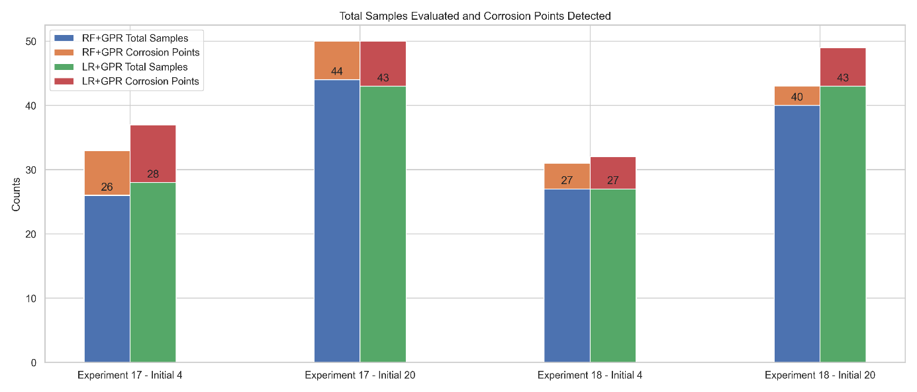
Results
Notes:
RF + GPR
Experiment 17 Initial sample = 4
Total iterations: 25 Total unique samples evaluated (including initial samples): 26
Total corrosion points detected (including initial samples): 7
Corrosion detected in iterations: [0, 3, 6, 8, 11, 15, 22]
Initial Sample 20
Total iterations: 25
Total unique samples evaluated (including initial samples): 44
Total corrosion points detected (including initial samples): 6
Corrosion detected in iterations: [1, 2, 5, 6, 15, 17]
Experiment 18 Initial Sample=4
Total iterations: 25 Total unique samples evaluated (including initial samples): 27
Total corrosion points detected (including initial samples): 4
Corrosion detected in iterations: [1, 7, 15, 19]
Initial Sample 20
Total iterations: 25 Total unique samples evaluated (including initial samples): 40
Total corrosion points detected (including initial samples): 3
Corrosion detected in iterations: [1, 11, 15]
LR + GPR
Experiment 17 Initial Sample 4
Total iterations: 25
Total unique samples evaluated (including initial samples): 28
Total corrosion points detected (including initial samples): 9
Corrosion detected in iterations: [0, 1, 3, 7, 9, 14, 18, 22, 24]
Initial Sample 20
Total iterations: 25
Total unique samples evaluated (including initial samples): 43
Total corrosion points detected (including initial samples): 7
Corrosion detected in iterations: [1, 2, 5, 9, 13, 16, 17]
Experiment 18 Initial Sample 4
Total iterations: 25
Total unique samples evaluated (including initial samples): 27
Total corrosion points detected (including initial samples): 5
Corrosion detected in iterations: [1, 5, 7, 16, 18]
Initial Sample 20 Total iterations: 25
Total unique samples evaluated (including initial samples): 43
Total corrosion points detected (including initial samples): 6
Corrosion detected in iterations: [1, 7, 11, 17, 23, 24]

Slide 9
Thank you!

